Slide 1

A-Way Database
A remodeling companies needs
Ryan Thorne, Ben Duong

Slide 2
PRoposal & Design Concept
The database that is need for my company must keep track of the data from clients and employees. The other main function of the database is to allow contracts that are from previous job's to be logged. The database also needs to keep track of Contracts, Scheduling, Location of job, Payments, Sales commissions, Material on hand, Material needed, Tools on hand. For every Employee We need to know if they are licensed or not.

Slide 3
Identified STRONG TYPE Entities/Stand Alone
CLIENTS
EMPLOYEES

Slide 4
Identified Weak TYPE Entities/Dependent Type/
CONTRACTS
CONTRACT_MATERIALS
MATERIAL_ON_HAND
CONTRACT_SCHEDULES
TOOLS_ON_HAND
CONTRACT_TOOLS
SALES_COMMISSION_RATES
PAYMENTS
SCHEDULES
JOB_LOCATIONS

Slide 5
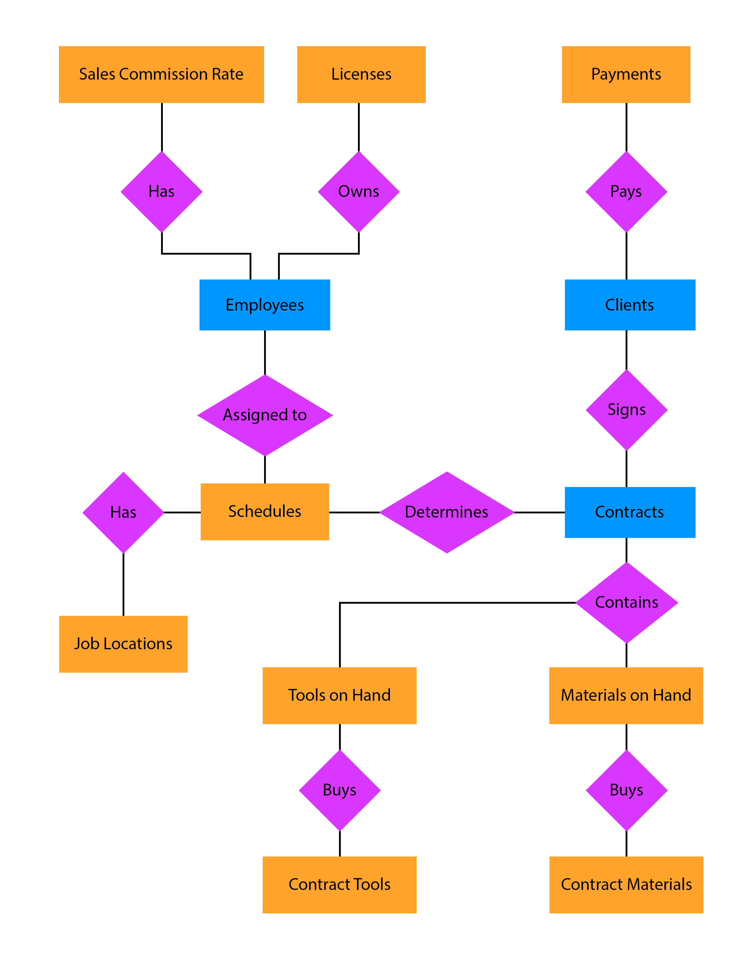
ERM
A_WAY DB ERM help to visualize the flow for daily operations. It also helps us to code our DB, and gain confidence on what tables can be joined and views capable to be made.

Slide 6
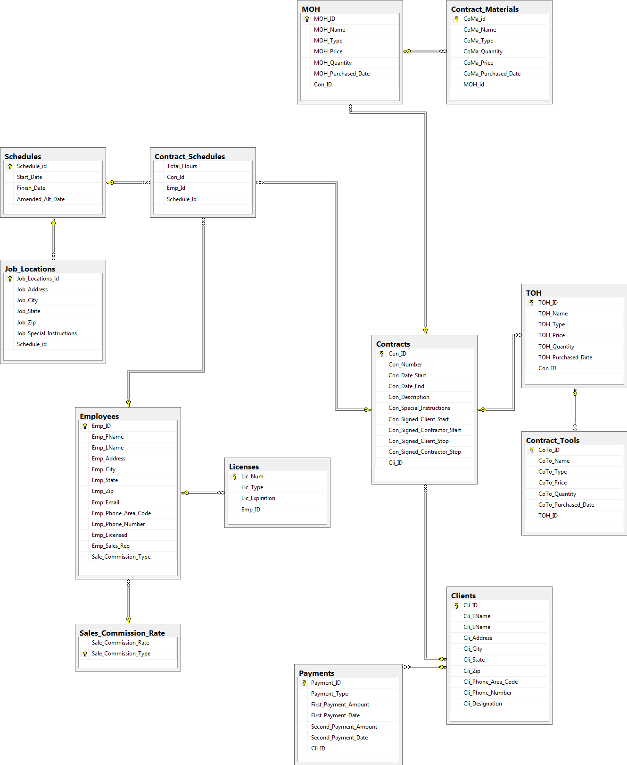
ERD
This ERD View Helps us
Situate what FK and PK are needed based on attributes. Once we normalized the data and made our attributes defined. The data base was ready for to be Implemented and tested with sample data.

Slide 7
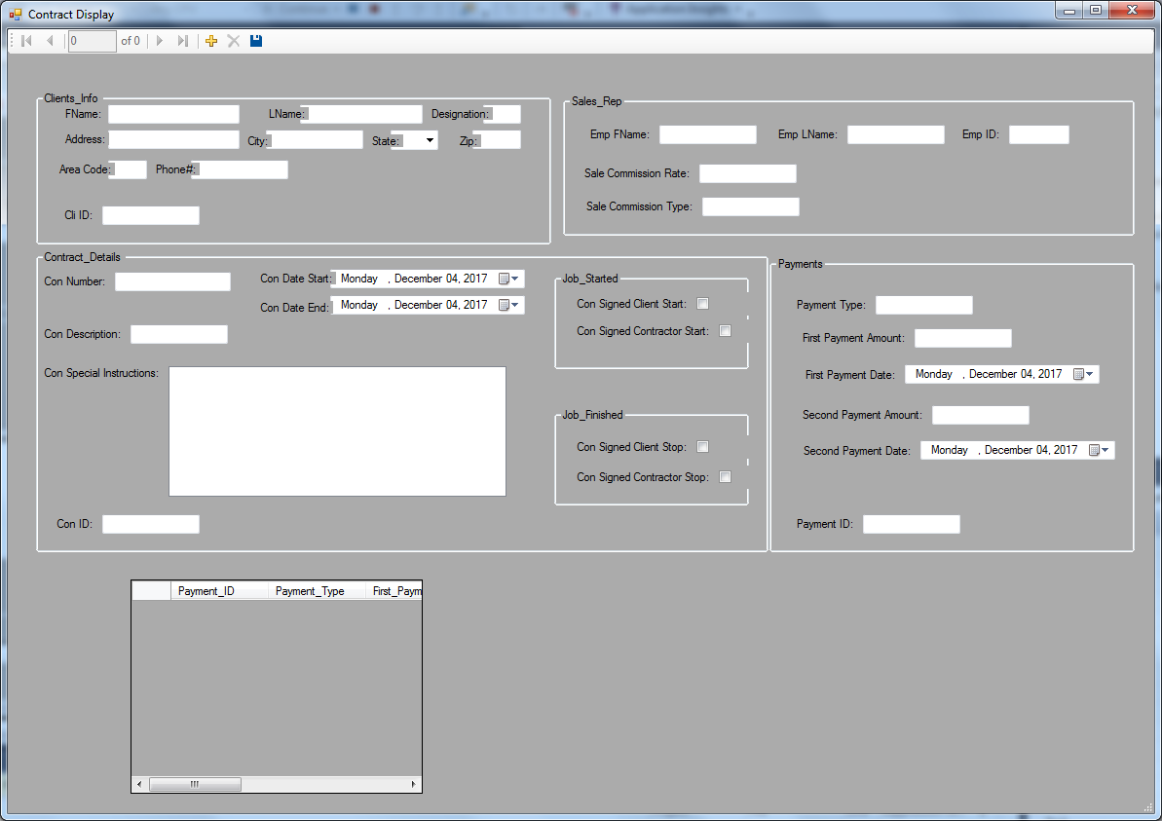
APPLICATION USE IN visual studio USING Databinding TOOLS
VB.NET
Contract View
Application side
User interface
GUI

